Slide 1
ONLINE HOSPITAL MANAGEMENT SYSTEM

Slide 2
Team Contribution
Aryan Birla: Back-end(Spring Boot)
Anukrati Gupta: Back-end + Front-end
Arisha Anjum: Front-end(React.js)
Guided By:
Sunil Kumar (Senior Project Engineer)

Slide 3
OBJECTIVE
A patient is registered to the hospital by filling up a form.
After filling up and submission using the interface, all data will be saved in the database to the corresponding tables.
The patient is registered and then he/she will book an appointment to visit a doctor .
Then this data is transferred to the allotted doctor where the doctor visits the patient and prescribes tests and medicines.
After the treatment is over the Record will be updated.

Slide 4
PROBLEM STATEMENT
The traditional methods used in the hospitals , the patients had to wait in a long queue.
This process was repeated at every step including the prescribed tests, taking reports, buying medicines, re-consulting the doctor and getting assigned the doctor which makes it a very time-consuming and exhausting.
Sometimes the patients are not so educated to fill the admission forms in the hospital which causes a delay in their admission and may sometimes lead to deprivation from the facilities provided by the government and the hospital

Slide 5
PROPOSED SOLUTION
The application provides an online database of the patients to the hospital as well as the patients, which helps in their further treatment.
Patients can be directly assigned the doctor and the doctor can view the patients’ medical history just by logging in into the patient’s database, eliminating the situations of waiting in queues.
This will also allow the receptionist and the hospital staff to help the not so educated part of the society, as the people standing in the queues will be less the receptionist can easily help the people who are not introduced to the latest technologies.
The traditional methods in the hospitals used were asking the patients to pay at every step but when the patients database is accessible to the hospital staff. Then the billing can be done at the time of the discharge of the patient not at every single point.

Slide 6
Number of Modules
There are three major modules
Admin
Doctor
Patient

Slide 7
ADMIN
Add Staff
View Staff
Delete Staff
Staff Details
Profile
Logout

Slide 8
DOCTOR
View Appointment
Update Availability Status
Profile
Logout

Slide 9
PATIENT
Book Appointment
View Appointment
Get Information
Cancel Appointment
Profile
Logout

Slide 10
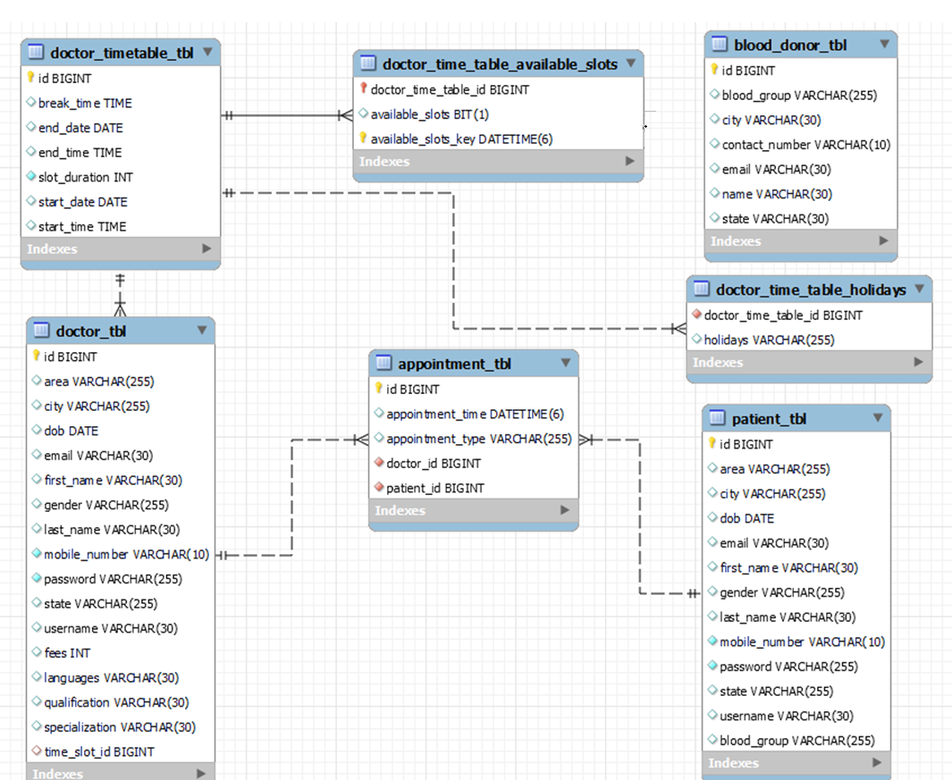
E-R Diagram

Slide 11
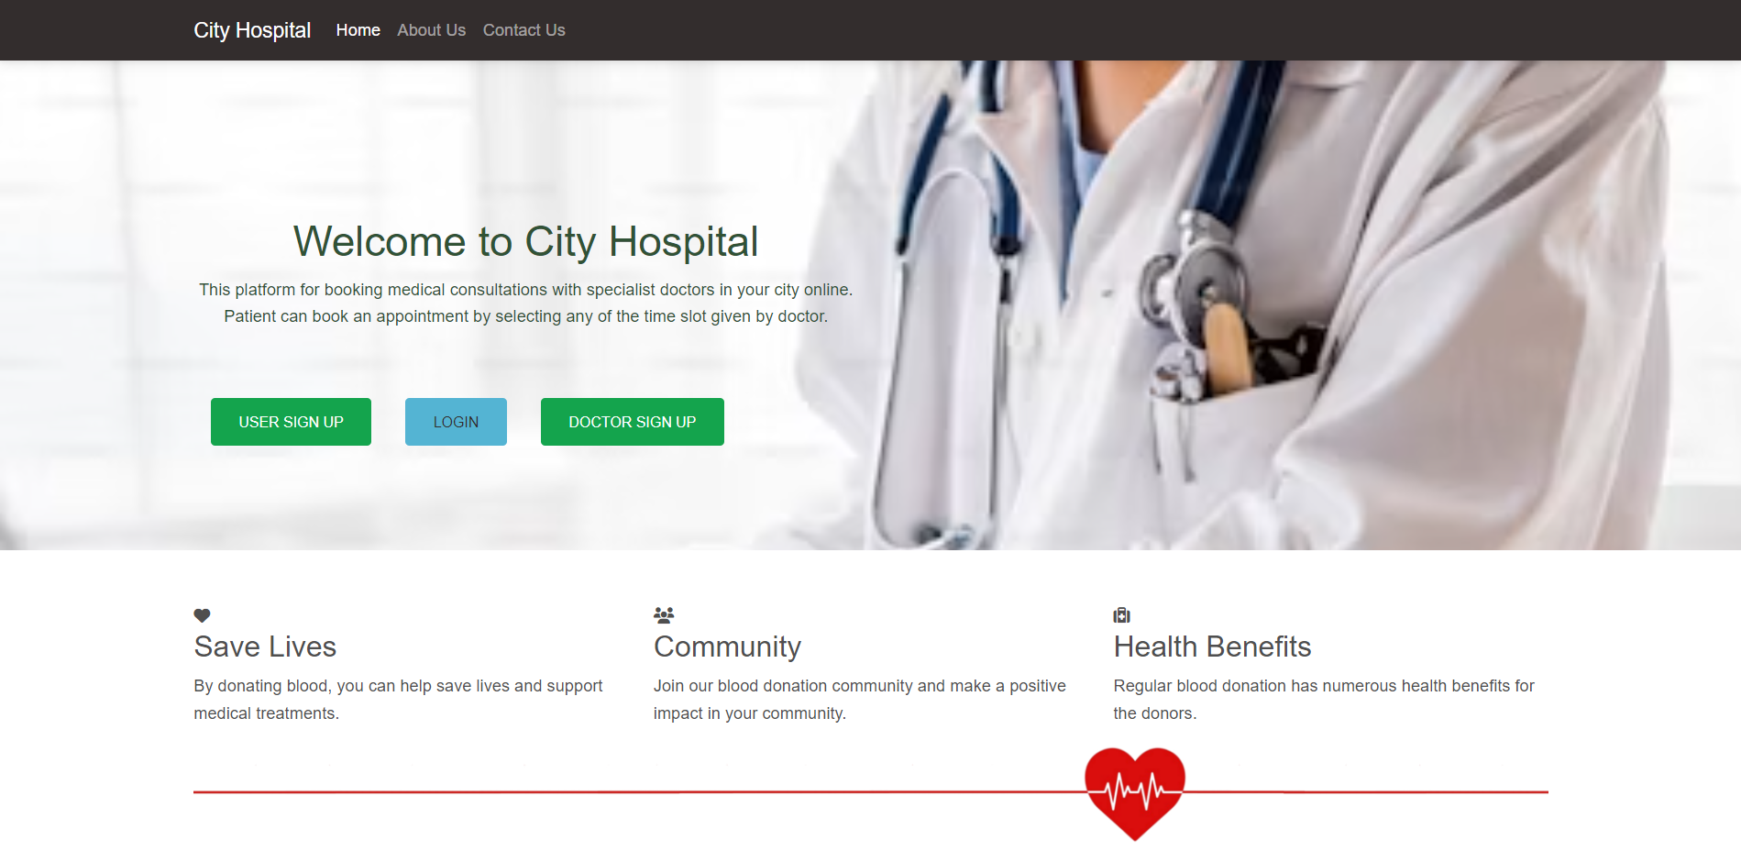
Home Page

Slide 12
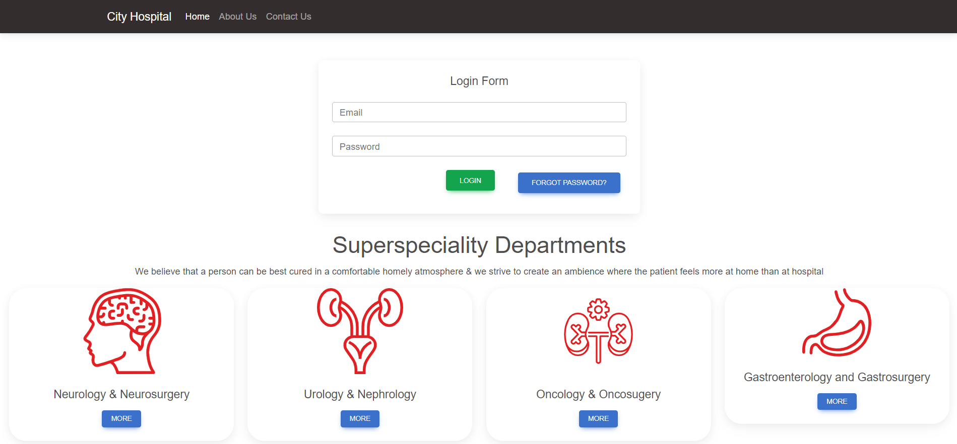
Login Page

Slide 13
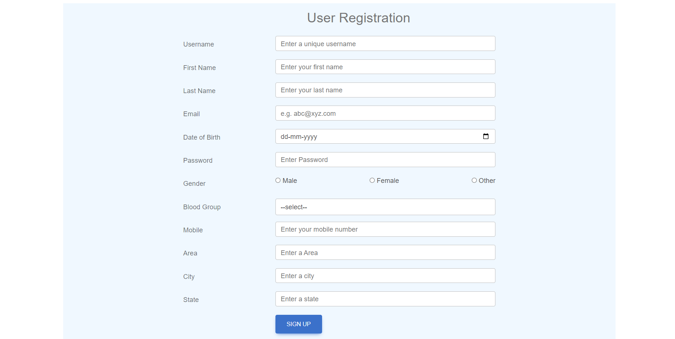
Sign Up Page

Slide 14
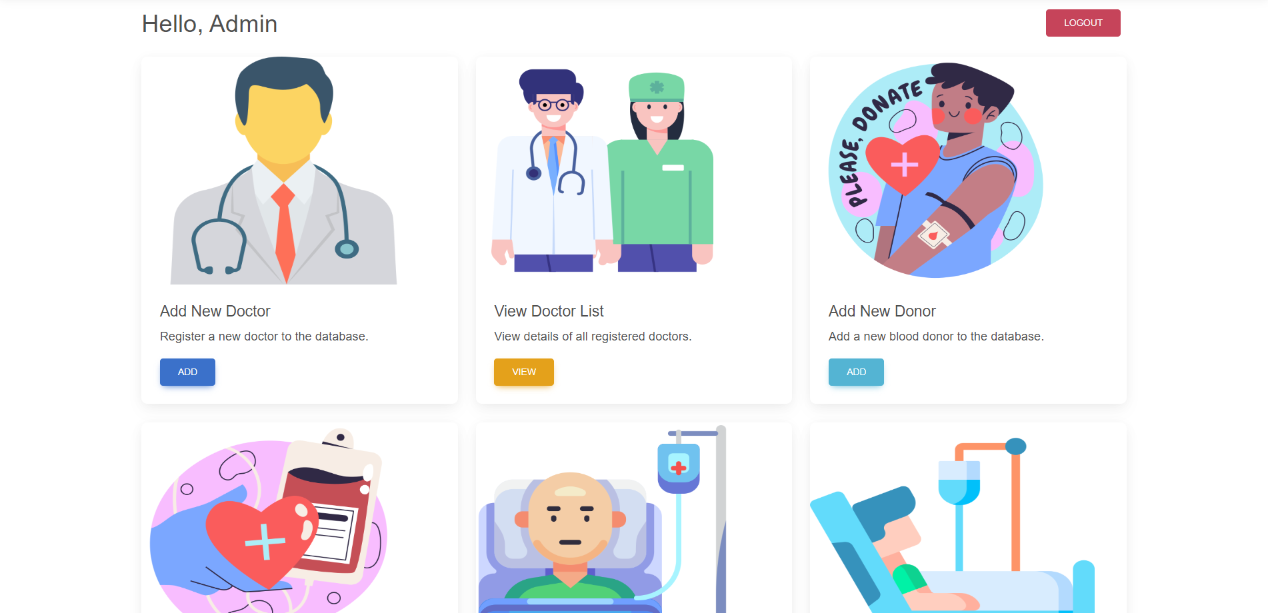

Admin Screen

Slide 15
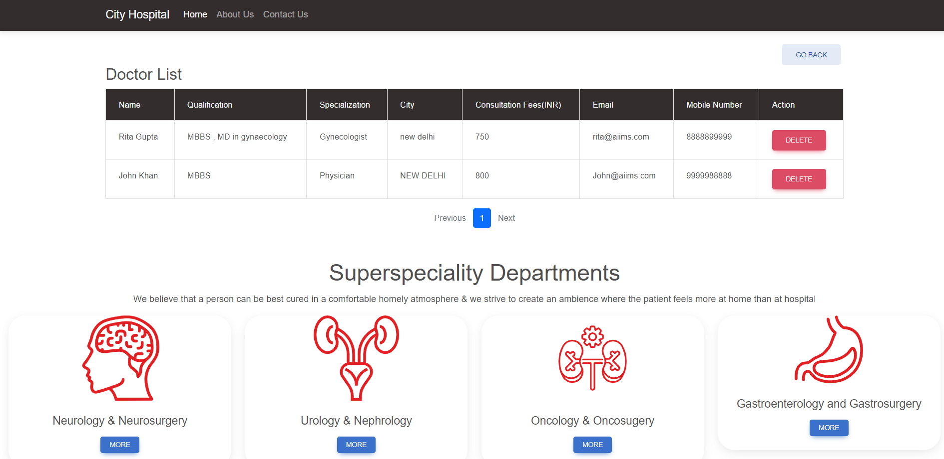
View Doctors

Slide 16

Add Patient

Slide 17
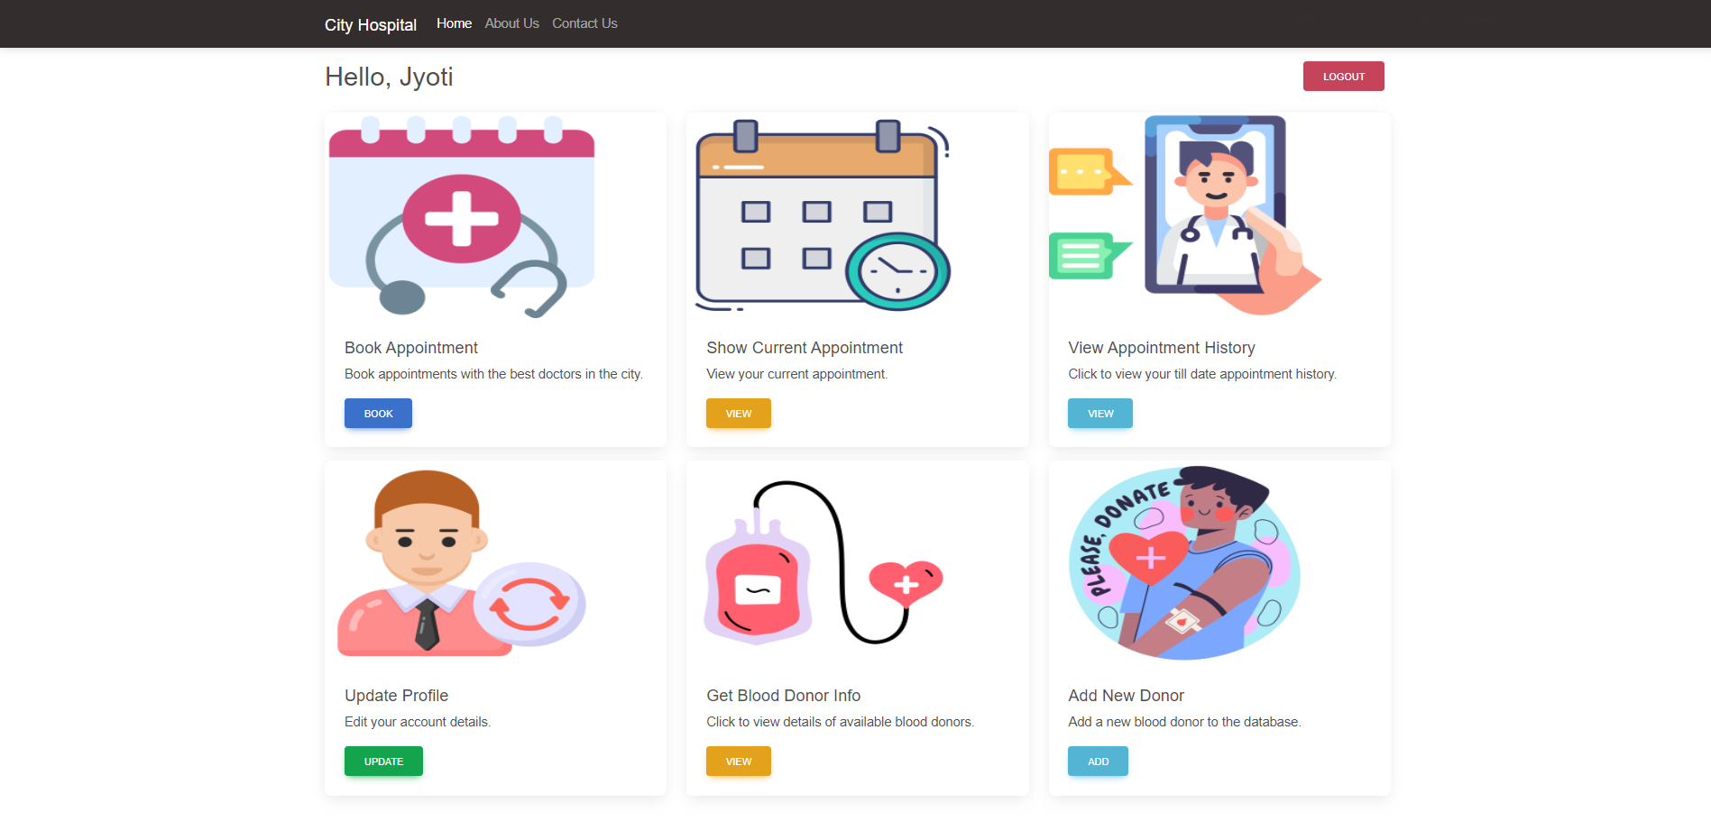
Patient Screen

Slide 18
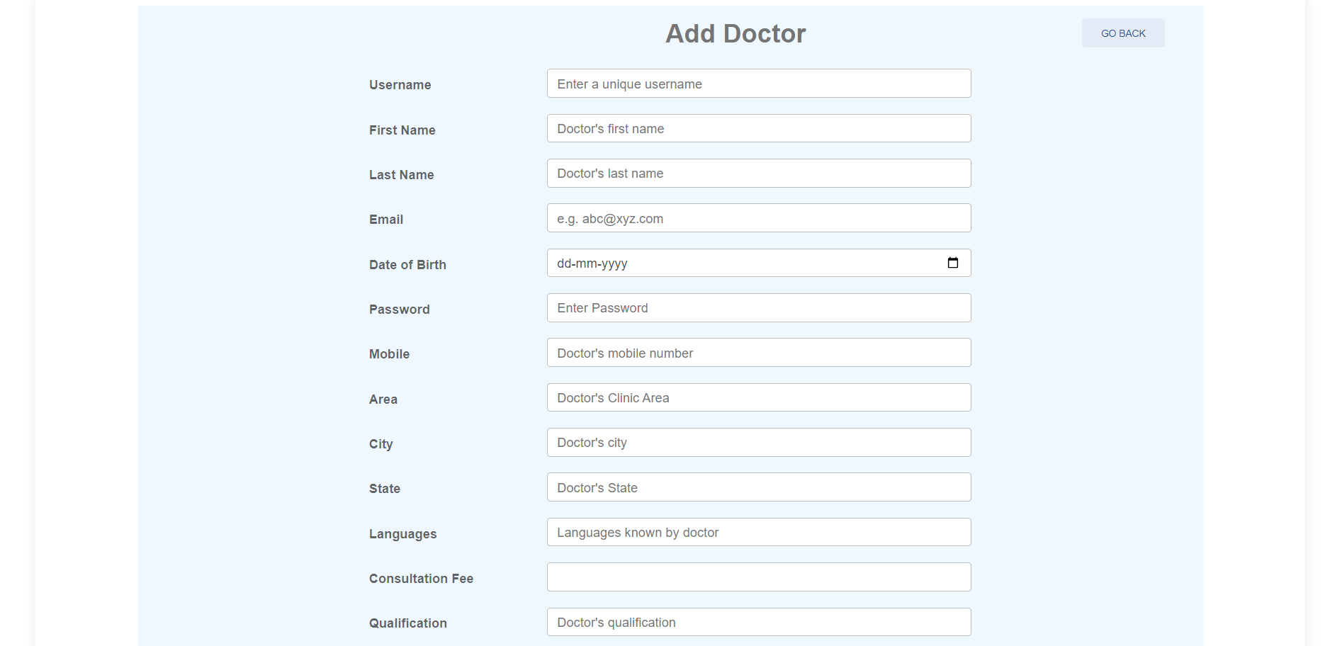
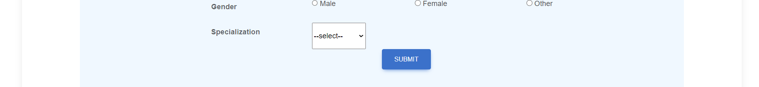
Add Doctor

Slide 19
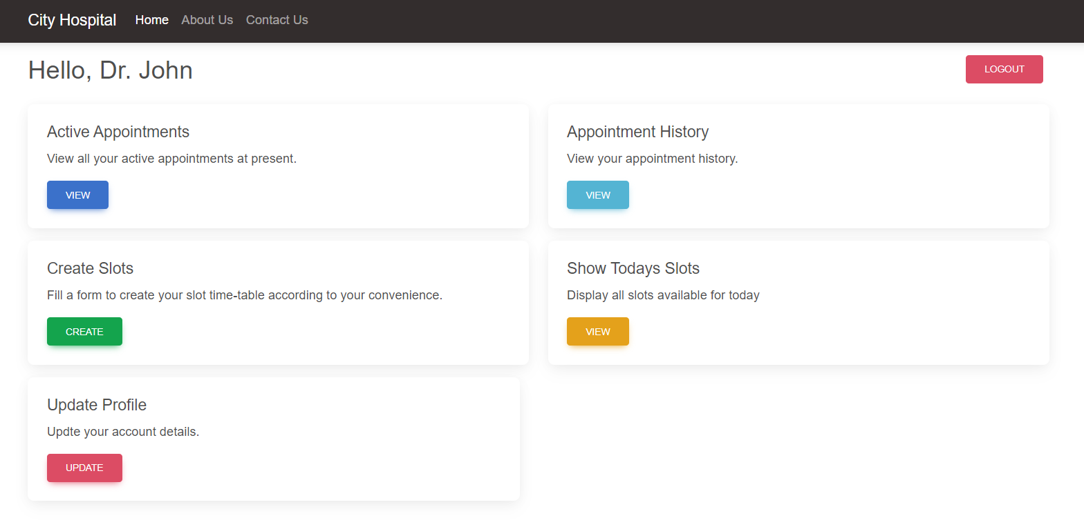
Doctor Screen

Slide 20
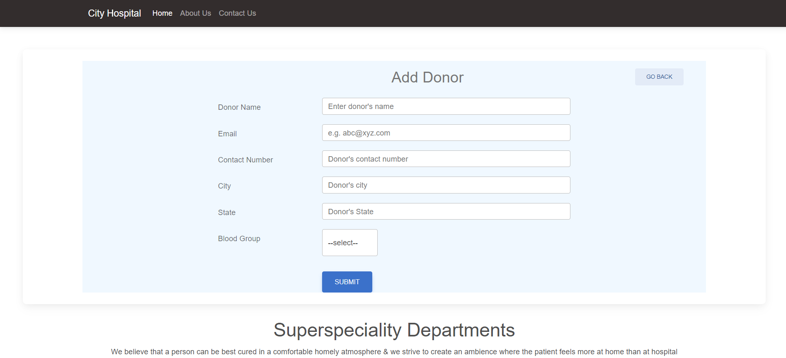
Add Donor

Slide 21
Conclusion
We minimize the efforts of the patients to book an appointment.
Our project will help to reduce the crowd contact, the patients are given appointment time slots to visit the hospital and meet the doctor. The doctor can also see the patients visiting and their health profile or symptoms.
We enable the hospital staff and management to securely save the data and fetch the data whenever necessary.
If any patient is not aware of the technology, he/she can register their data securely via admin.
3 kinds of users namely admin, doctor and patient.
We have given the service to change the password after validating the user data.
We have provided static as well as dynamic pages to display data. Every specified user has our functionalities.

Slide 22
REFERENCES
Links:
https://getbootstrap.com/docs/5.1/customize
https://www.w3schools.com/css/
https://docs.oracle.com/javase/8/docs/api/
https://stackoverflow.com/
https://javaee.github.io/javaee-spec/javadocs/
https://developer.mozilla.org/en-US/docs/Web/JavaScript
https://hibernate.org/orm/
https://reactjs.org/

Slide 23
THANK YOU

